Slide 1

Intelligent Agents and Multiagent Systems
Equilibria computation with fictitious play And q-learning
Aris tsilifonis- mtn2323

Slide 2
Zero sum games
Zero-sum games are a specific example of constant sum games where the sum of each outcome is always zero
Zero-sum games can be presented in a way of a matrix, which is called Normal Form
Column player
Row player
 | Heads | Tails
Heads | 1,-1 | -1,1
Tails | -1,1 | 1,-1

Slide 3
Nash Equilibrium
There are two types of strategies, pure and mixed
If a player chooses playing strategies randomly, then this player is using a "mixed strategy"
In a pure strategy a player chooses an action for sure, whereas in a mixed strategy, he chooses a probability distribution over the set of actions available to him
Best response is a strategy that generate the greatest payoff for him or her given what the other players are doing
A Nash equilibrium is a pair of strategies such that neither player can gain by a unilateral change of strategies

Slide 4
Learning and Teaching
A repeated game is an extensive form of game that is played over multiple rounds
2 player games of 2 or 3 possible actions were considered(2x2 or 3x3 payoff matrices)
Fictitious agent vs Fictitious agent
Q-Learning Agent vs Q-Learning Agent
Fictitious agent vs Q-Learning Agent

Slide 5
Fictitious play
Fictitious play refers to a dynamic process where at each stage, players play a (pure) best response to the empirical distribution of their opponent’s play.
(1-α )*(average self strategy) + α *best response
Algorithm
Initialize beliefs about the opponent’s strategy
Repeat n episodes:
Play best response to the addressed strategy of the opponent
Observe the opponents actual play and update beliefs accordingly

Slide 6
Reinforcement Learning
Reinforcement Learning (RL) is a type of machine learning paradigm that is concerned with how agents ought to take actions in an environment to maximize some notion of cumulative reward
Model-based RL: The agent builds a model of the environment’s dynamics and uses it to make decisions.
Model-free RL: The agent learns policies or value functions based on the observed rewards without any model of the environment’s dynamics.

Slide 7

Q-Learning
The maxmin (or maximin) strategy in game theory is a decision rule used by a player to maximize the minimum gain that can be achieved under any scenario.
It reflects a strategy where a player prepares for the worst-case scenario by choosing the action that provides the best of the worst possible payoffs.
$Q\left(s,a_{1},a_{2}\right)=\left(1−a\right)Q\left(s,a_{1},a_{2}\right)+a\left(r+γV\left(s^{′}\right)\right)$
$π_{1}\left(s, .\right)= \underset{π_{1}εPD\left(A_{1}\right)}{argmax}\min_{α_{2}εA_{2}}\sum_{a_{1εA_{1}}}{π_{1}\left(s,a_{1}\right)Q_{1}(s,a_{1},a_{2})}$

Slide 8

Q-Learning
$V_{1}\left(s\right)=\min_{α_{2}εA_{2}}{\sum_{a_{1εA_{1}}}{π_{1}\left(s,a_{1}\right)Q(s,a_{1},a_{2})}}$
The π needs to be computed with linear programming
Choose an action:
Based on an exploring probability, return an action uniformly at random
Otherwise, return action $a_{1}$ with probability $π_{1}$
Exploration vs Exploitation

Slide 9

Matching Pennies Game
p
1-p
 | Heads | Tails
Heads | 1,-1 | -1,1
Tails | -1,1 | 1,-1
q
1-q
Let p be the probability of player 2 plays Heads , and q be the probability of player 1 plays heads. Player 1 uses heads if:
[0.5,0.5] row player
Mixed strategy Nash Equilibria
$$1∗p+\left(−1\right)∗\left(1−p\right)≥\left(−1\right)∗p+1∗\left(1−p\right)$$
$$p−1+p≥−p+1−p$$
$$2p−1≥1−2p$$
$$4p≥2$$
$$p≥\frac{1}{2}$$
Payoff to tails
Payoff to heads

Slide 10
Matching Pennies Game
The expected payoff of both row and column player is 0
There are no pure strategy Nash equilibria in this game
If no equilibrium exists in pure strategies, one must exist in mixed strategies
A mixed strategy is a probability distribution over two or more pure strategies
If mixtures are mutual best responses, the set of strategies is Nash equilibrium

Slide 11
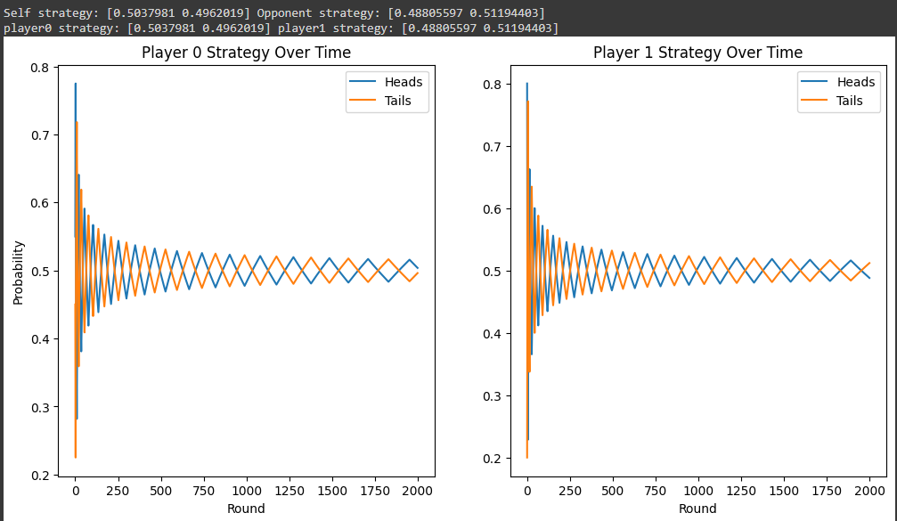
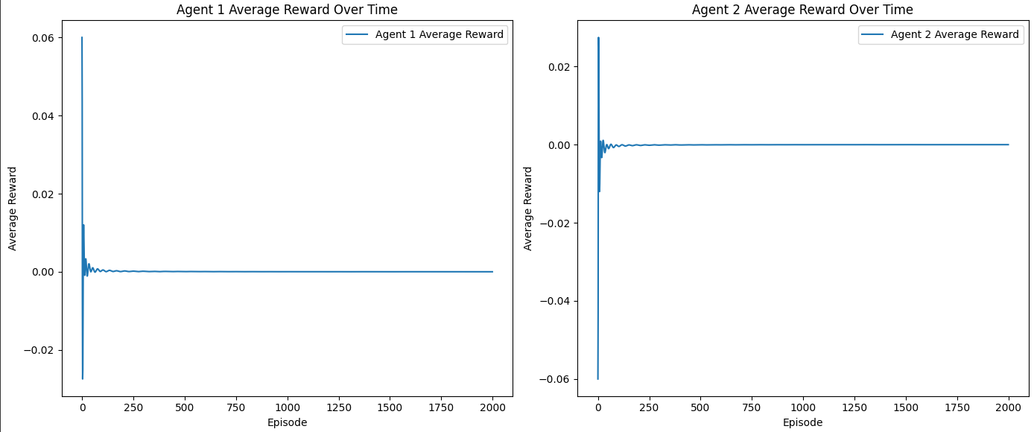
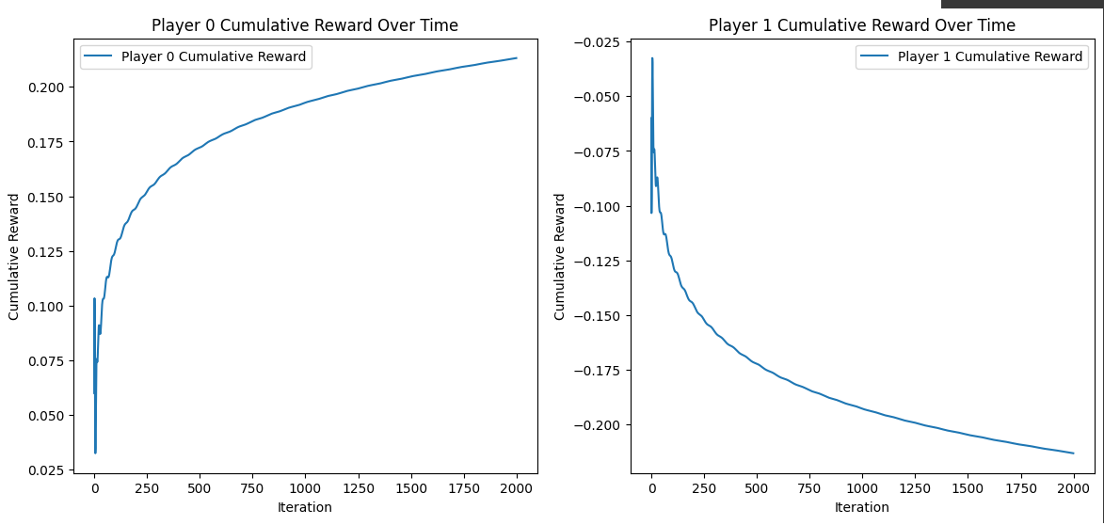
FP VS FP Matching Pennies

Slide 12
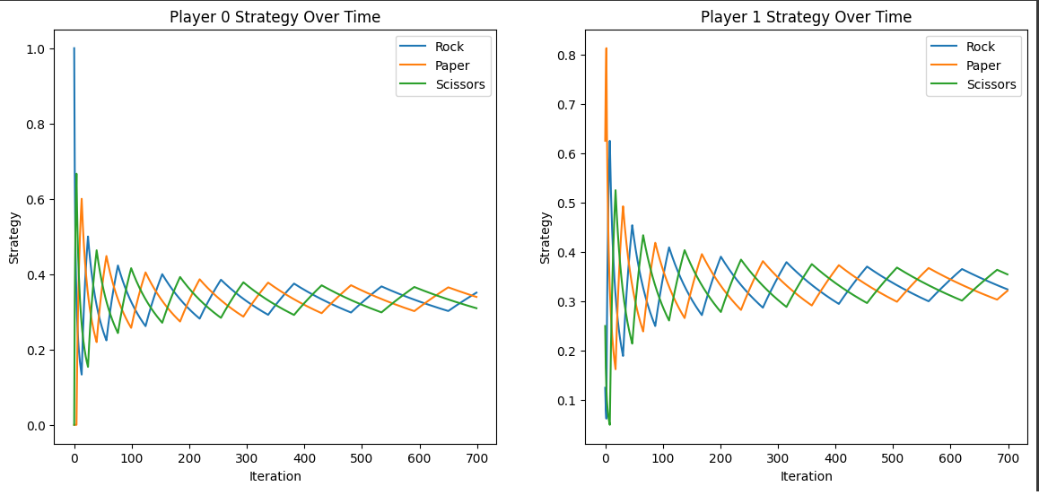
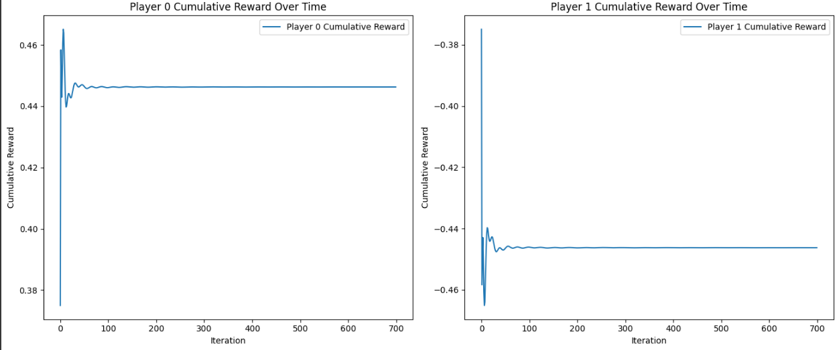
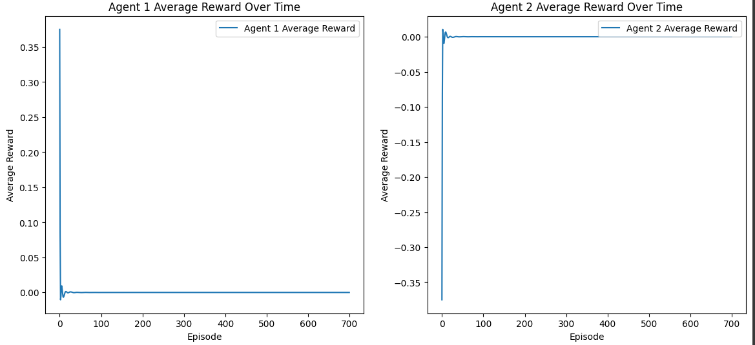
FP VS FP Rock Paper Scissors

Slide 13
FP VS FP Rock Paper Scissors

Slide 14
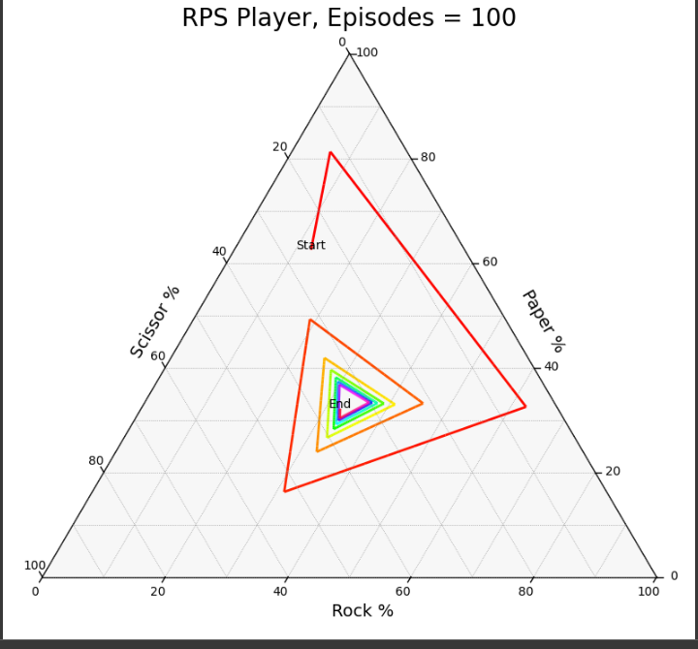
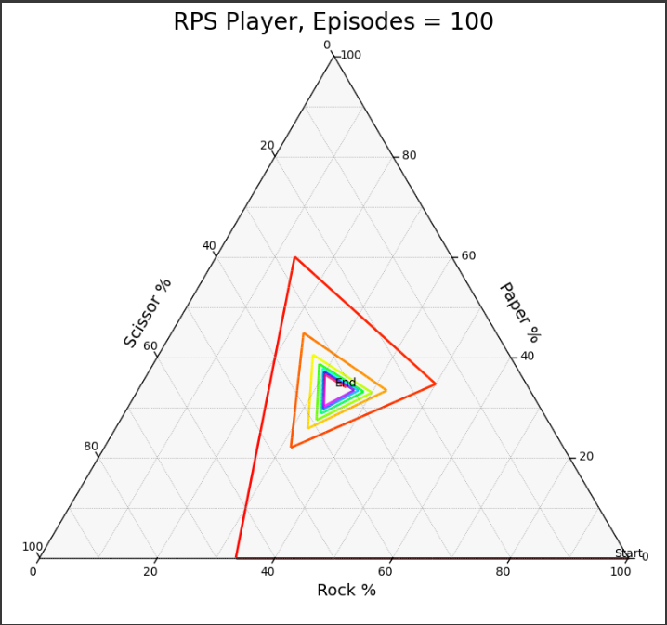
FP VS FP Rock Paper Scissors

Slide 15
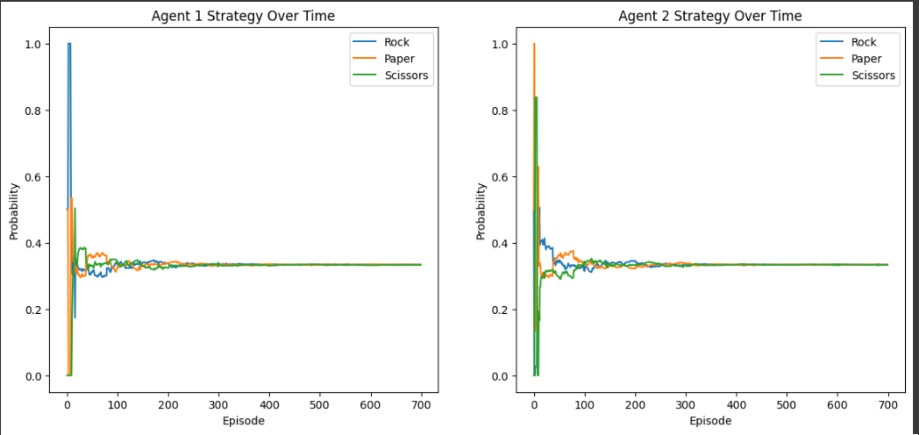
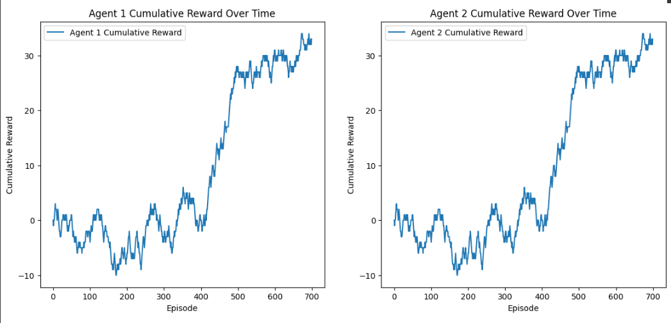
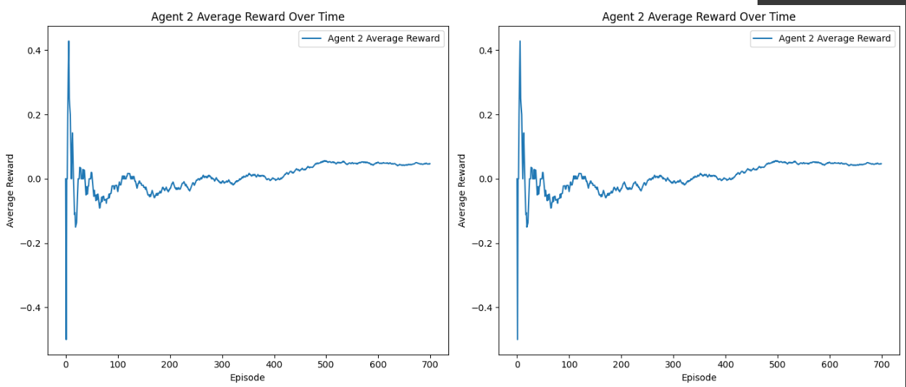
RL VS RL Rock Paper Scissors

Slide 16
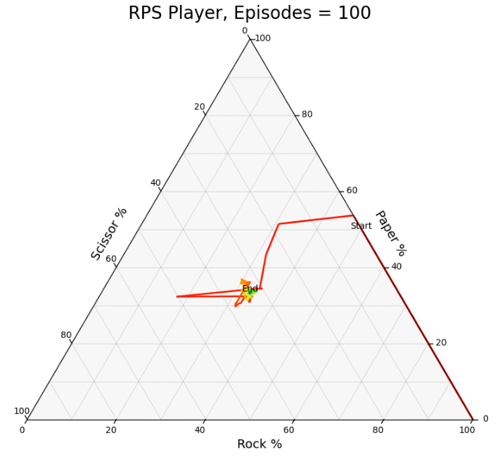
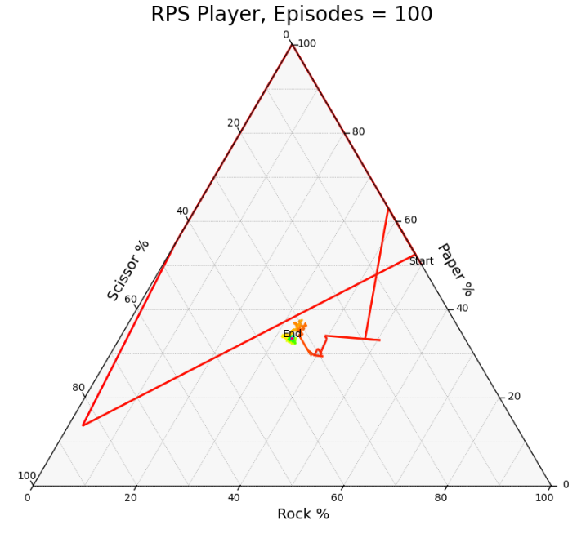
RL VS RL Rock Paper Scissors

Slide 17
RL VS RL Rock Paper Scissors

Slide 18
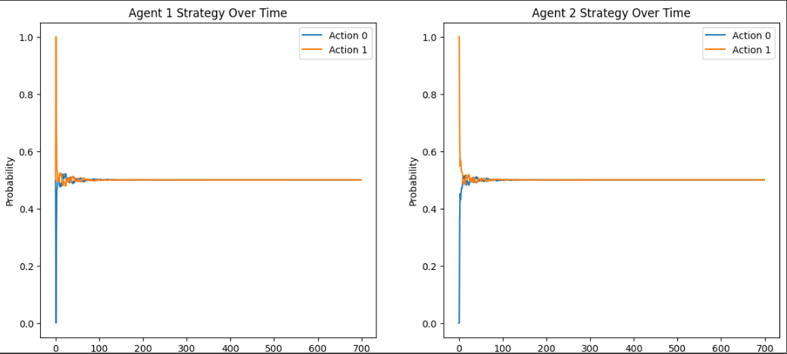
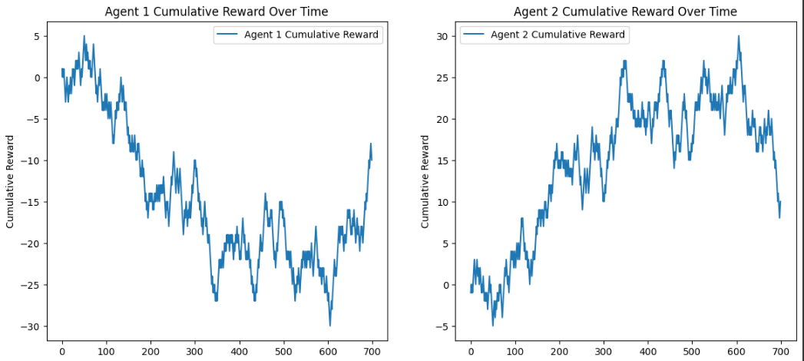
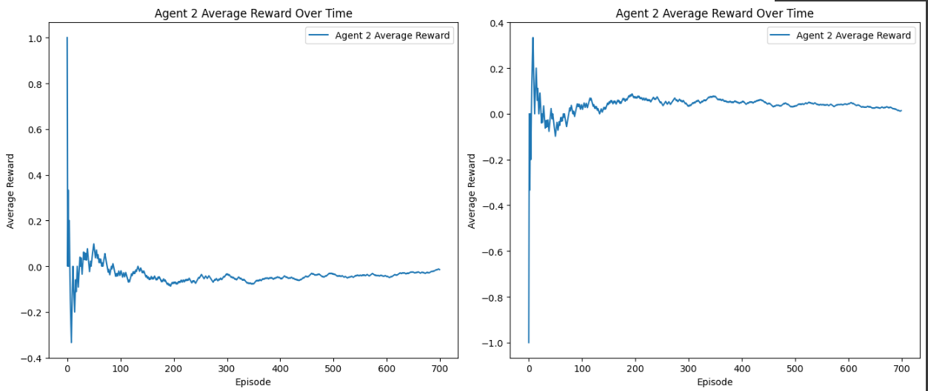
RL VS RL Matching Pennies

Slide 19
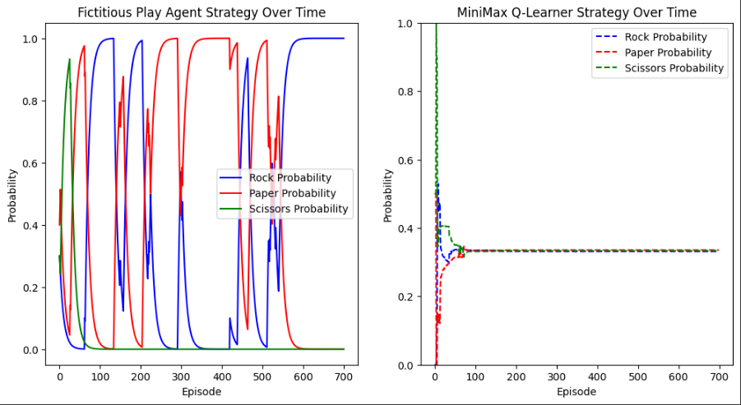
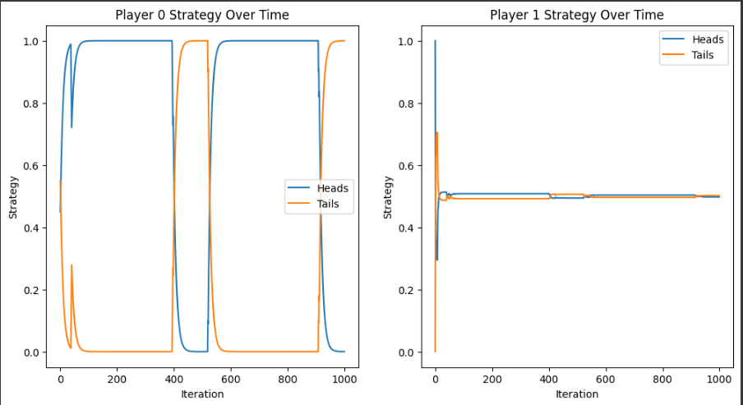
FP VS RL
Rock Paper Scissors
Matching Pennies

Slide 20
Games with more than one equilibria
Selling damaged goods
 | Buy | Pass
Keep | 1,-1 | -1,1
Sell | -1,1 | -1,1
2 Nash Equilibria in pure strategies: Keep,Pass and Sell,Pass

Slide 21
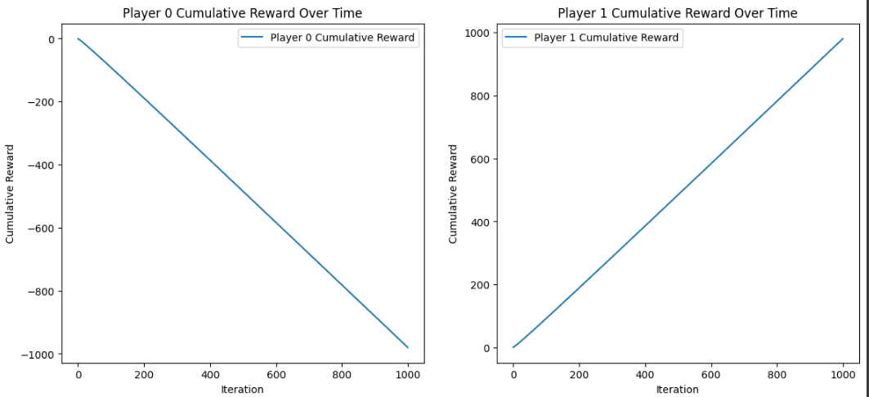
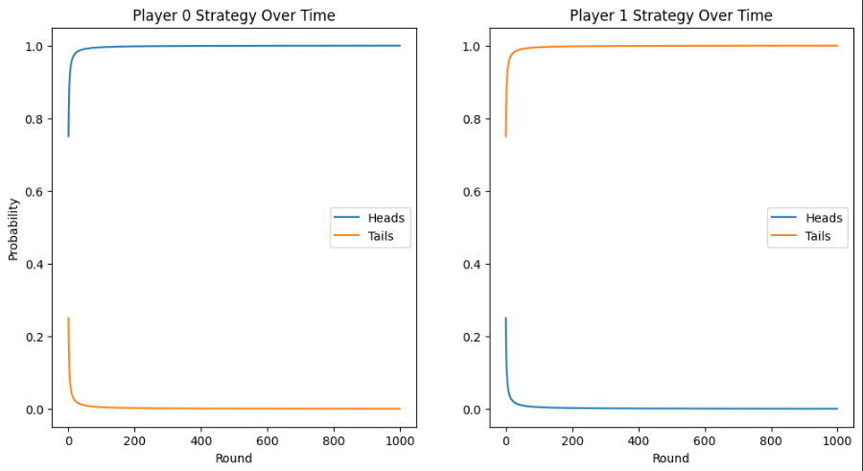
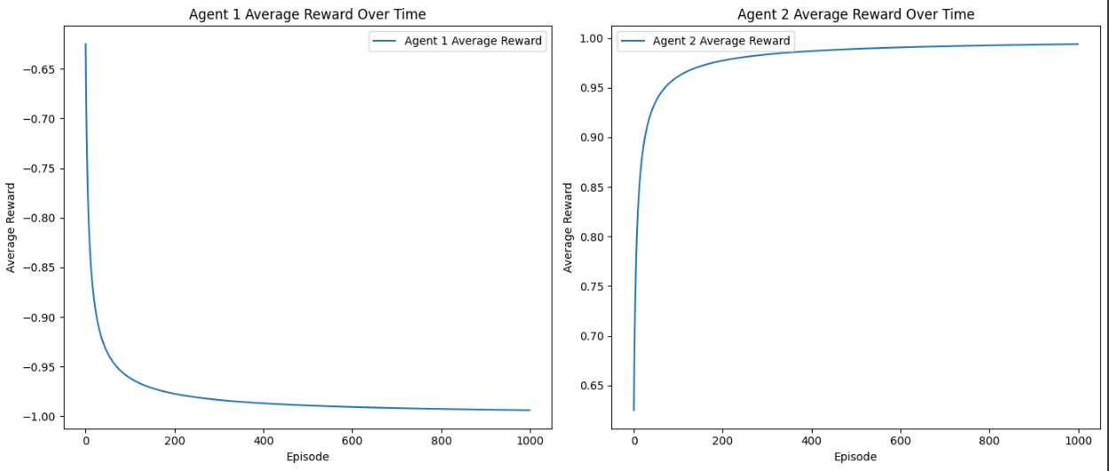
Games with more than one equilibria FPvsFP
Selling damaged goods

Slide 22
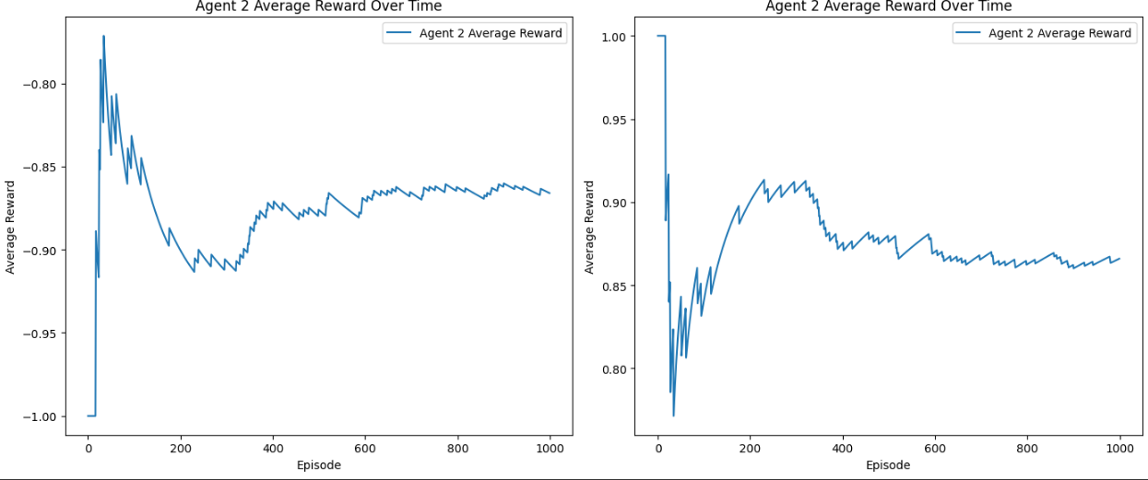
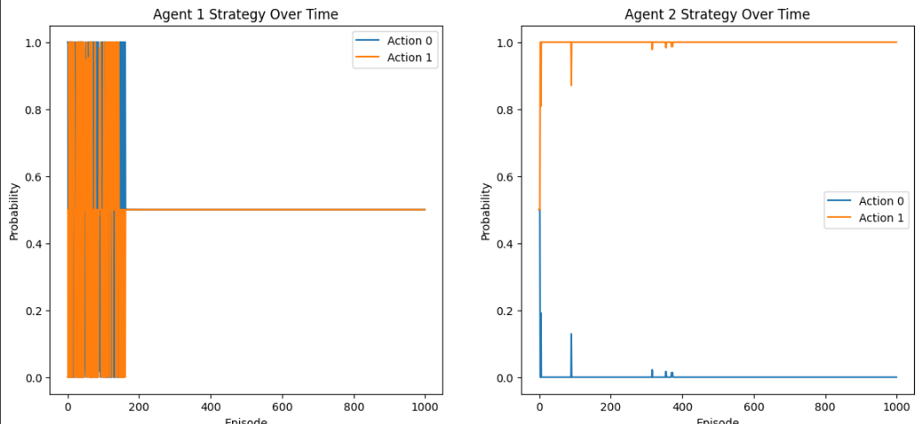
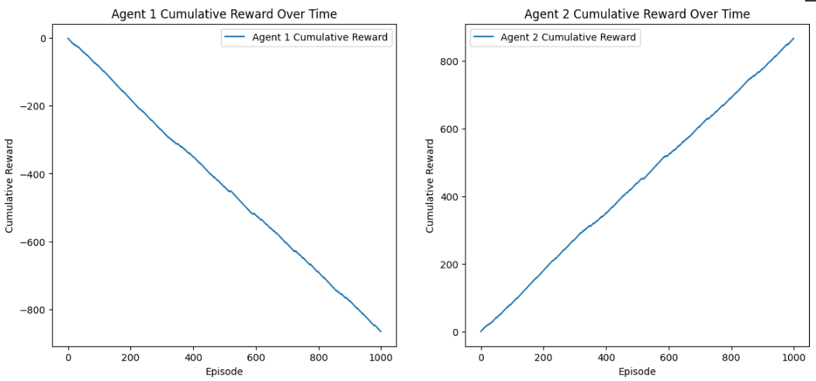
Games with more than one equilibria RLvsRL

Slide 23
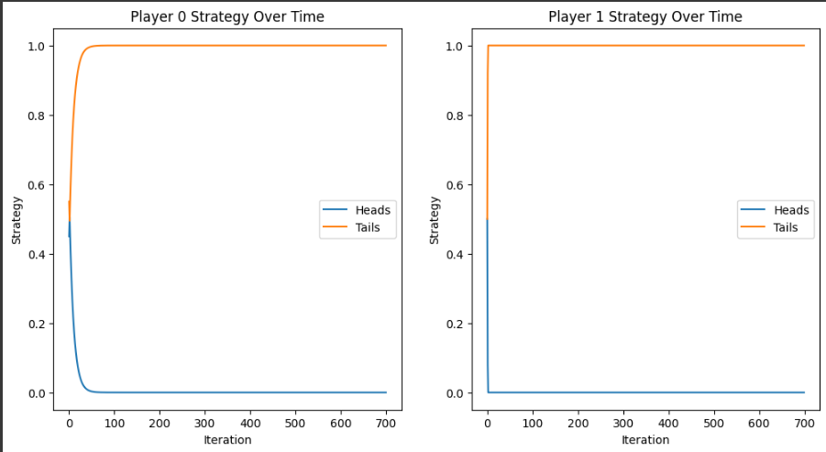
Games with more than one equilibria FPvsRL

Slide 24
Conclusions
FP depends on initial beliefs(In some experiments the action probability graph differentiated)
RL is not affected much by initial parameters
FP converges smoother than RL
Similar rate of convergence(Early convergence)
FP vs RL graphs differentiate a lot after each experiment

